Slide 1
Transformation Networks for Target-Oriented Sentiment Classification Xin Li, Lidong Bing, Wai Lam and Bei Shi Department of Systems Engineering and Engineering Management The Chinese University of Hong Kong, Hong Kong Tencent AI Lab, Shenzhen, China
ACL 2018
任飞扬 2018/11/23
code is open-source and available at https://github.com/lixin4ever/TNet

Slide 2
目标和研究现状
Target-Oriented Sentiment Classification（面向目标的情感分类）：
对句子中出现的明显的“意见目标”确定情感极性。
例子：I am pleased with the fast log on, and the long battery life.
对log on和battery life两个target确定一个正向的情感。
RNN with attention achieves the state-of-the-art performance.

Slide 3
问题
问题1：对句子中的每个词（each context word and the target）分配一个 attention权重，然后结合这些权重特征来分类，会引入噪音、造成预测准确度下降。
例子1：This dish is my favorite and I always get it and never get tired of it.
问题2：CNN能有效抽取informative n-gram features（抽取关键短语如“is my favorite”）。但是对于一个句子中有多个target，对应多个sentiment，CNN会失效。
例子2：great food but the service was dread.

Slide 4
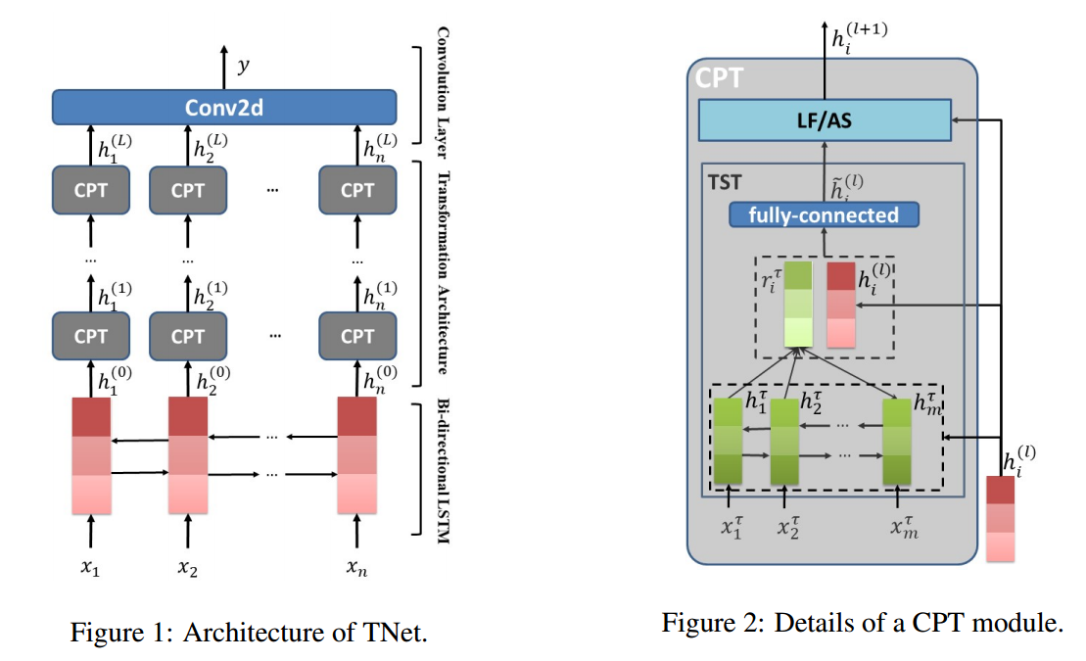
TNet: Target-Specific Transformation Networks

Slide 5







Model Description
对应的词向量为：

Slide 6





BiLSTM
input
Contextualized word representations

Slide 7


CPT: Context-Preserving Transformation
TST：Target-Specific Transformation
Step1: another BiLSTM
Obtain the target word representations:

Slide 8

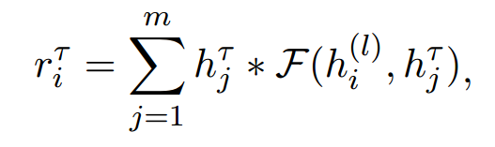


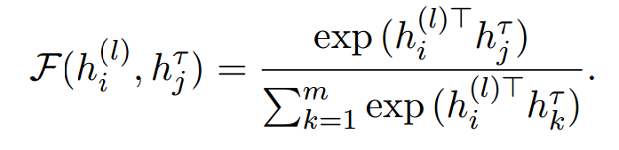
CPT: Context-Preserving Transformation
Step2: 计算

Slide 9


CPT: Context-Preserving Transformation
Step3: 计算
TST的作用：
TST首先基于每个上下文单词的表示，产生不同的目标表示。然后每个上下文单词和与之匹配的目标表示结合，从而得到转换的单词表示。

Slide 10
LossLess Forwarding(LF) and Adaptive Scaling(AS)
TST的非线性激活函数会丢失上下文信息。
为了充分利用上下文信息，将之传递给下一层，提出两种策略：LF和AS。
对应的模型分别命名为TNet-LF和TNet-AS。

Slide 11
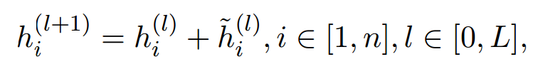


LF：Lossless Forwarding
展开迭代式：

Slide 12
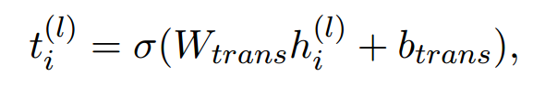

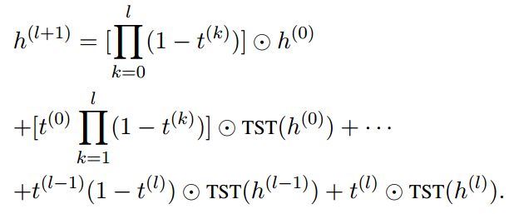
AS: Adaptive Scaling
能不能动态调整输入特征和转换特征的权重？
引入一个门函数：

Slide 13
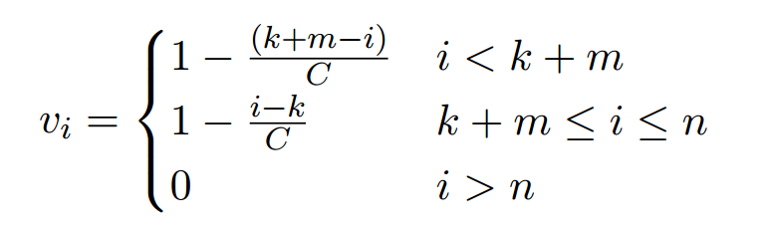

Convolutional Feature Extractor
问题2：great food but the service was dread.
dread对food有干扰。
Adopt a proximity strategy:
离target越近的词越可能形容target。

Slide 14
Convolutional Feature Extractor
问题2：great food but the service was dread.
dread对food有干扰。
Adopt a proximity strategy:
离target越近的词越可能形容target。

Slide 15
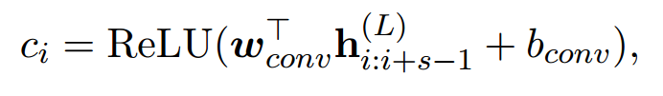


Convolutional Feature Extractor
卷积：
最大池化：
全连接层：

Slide 16
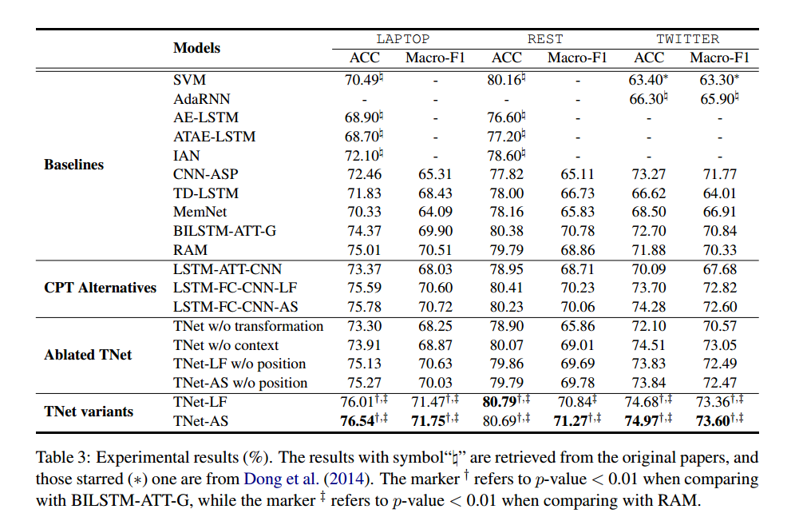
Experiments

Slide 17
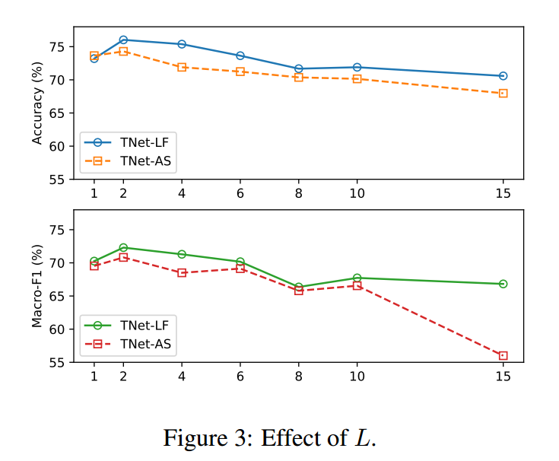
Effect of L

Slide 18
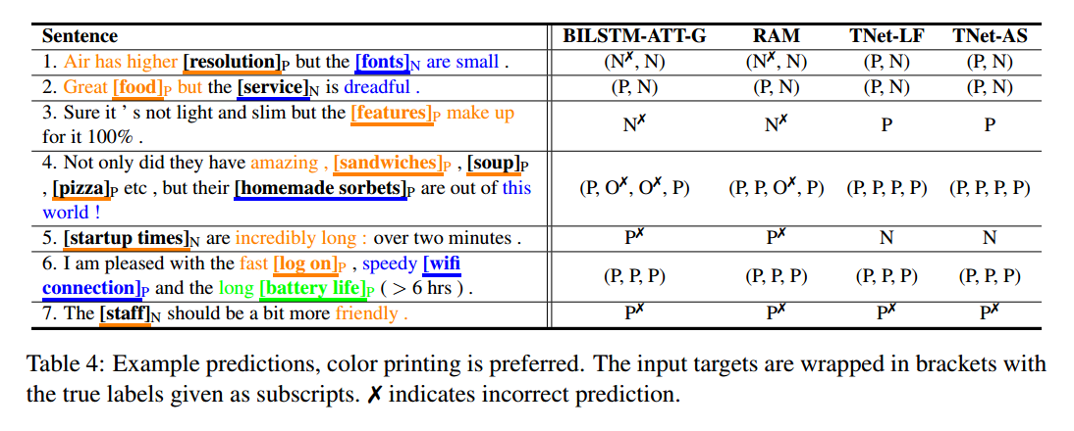
Case Study

